Slide 1
Intelligent System for Predicting Bank Policy Acceptance by Ensemble Machine Learning and Model Explanation
Remigio Hurtado, Eduardo Ayora

Slide 2
CONTENT:
Introduction
Problem
Aim
Method
Results y discussion
Conclusions
Social implications
References

Slide 3
INTRODUCTION:
Efficient Financial Management: Essential for bank sustainability and competitiveness.
Term Deposit Optimization: Crucial for maintaining liquidity and financial stability.
Intelligent System: Combines Random Forest and K-Nearest Neighbors (KNN) for improved predictions and model explanation.
CRISP-DM Methodology: Structured approach for data preparation, modeling, and explanation.
Key Benefits: Enhanced prediction accuracy, transparency, and actionable insights for telemarketing strategies.

Slide 4
PROBLEM:
Resource Management: Banks struggle with efficient allocation and optimization of term deposits.
Prediction Accuracy: Existing models may lack precision in predicting deposit acceptance.
Cost Reduction: High costs associated with ineffective marketing strategies.
Trust and Transparency: Need for clear explanations to build customer trust in decision-making.
Adaptability: Difficulty in adjusting strategies based on new data and changing conditions.

Slide 5
AIM:
Develop Advanced System: Create a predictive model using ensemble techniques (RF & KNN) to optimize term deposit subscriptions.
Enhance Accuracy: Improve prediction accuracy and reliability through combined machine learning approaches.
Ensure Transparency: Provide clear, interpretable explanations for model predictions to support informed decision-making.
Follow CRISP-DM: Apply a systematic framework for data processing, modeling, and explanation.
Adapt and Innovate: Design a system that adapts to new data and evolves with financial market trends.

Slide 6
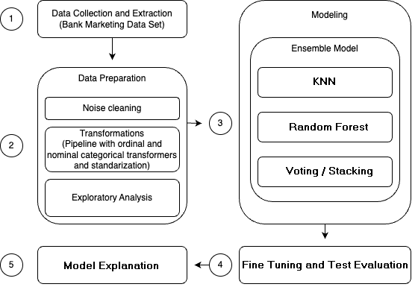
METHOD:

Slide 7
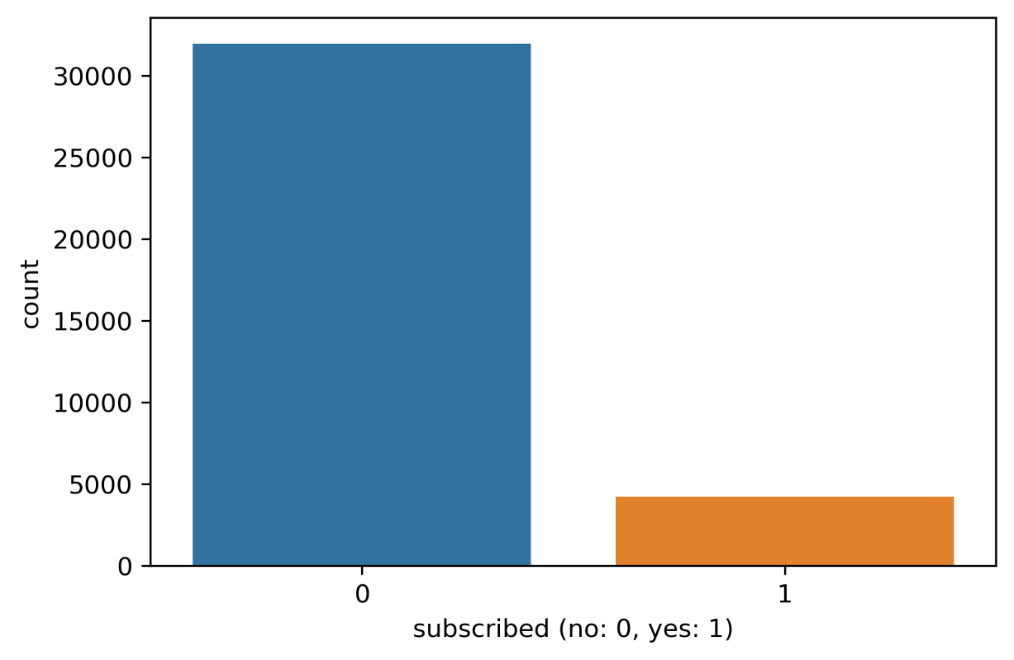
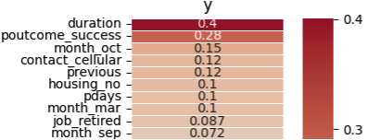
RESULTS AND DISCUSSION
Phase: Data Preparation

Slide 8
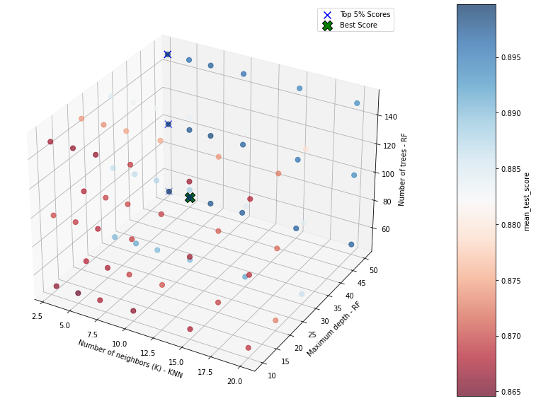
RESULTS AND DISCUSSION
Phase:
Fine Tuning

Slide 9
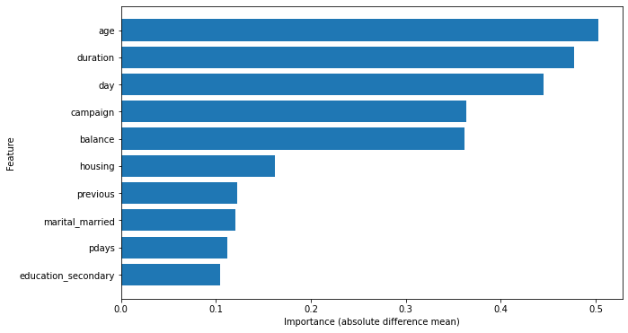
RESULTS AND DISCUSSION
Phase: Model Explanation - KNN

Slide 10
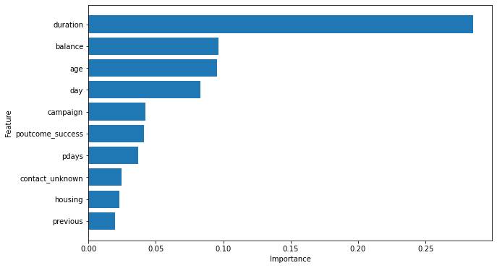
RESULTS AND DISCUSSION
Phase: Model Explanation – Random Forest

Slide 11
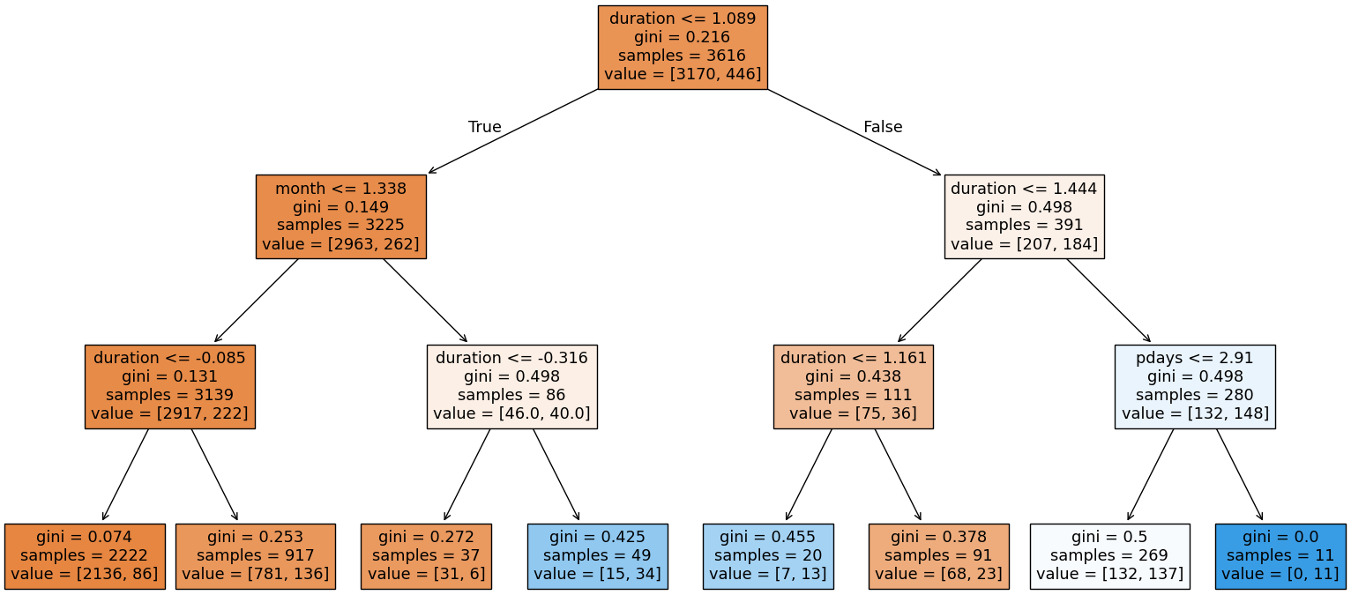
RESULTS AND DISCUSSION
Phase: Model Explanation – Random Forest

Slide 12
CONCLUSIONS
Research Contributions:
Advanced Decision Support System:
  Integrates RF and KNN models for enhanced prediction accuracy and transparency.
  Follows the CRISP-DM methodology for systematic data preparation, modeling, fine-tuning, and explanation of predictions.
  Validates initial hypotheses and refines telemarketing strategies for improved prediction accuracy and effectiveness.

Slide 13
CONCLUSIONS
Key Insights for Telemarketing Strategies
  Duration of interactions.
  Customer’s history of prior contacts.
  Customer demographics (education, marital status, account balance).

Slide 14
CONCLUSIONS
Overall Benefits:
  Improves predictive performance.
  Offers a reliable and explainable framework for decision support in dynamic financial environments.
  Contributes to better financial planning and resource management in banks.

Slide 15
SOCIAL IMPLICATIONS
Marketing Efficiency: Optimize campaigns and cut costs by analyzing key factors.
Personalization: More relevant offers based on contact duration and demographics.
Transparency: Builds customer trust by clarifying decision-making processes.
Financial Inclusion: Create more inclusive products for underserved segments.
Resource Optimization: Reduce inefficiencies and use resources responsibly.
Innovation: Drive competition and develop new strategies in finance.
Tech Adaptation: Training needed for users on new technologies.
Data Protection: Ensure privacy and compliance with data protection regulations.

Slide 16
REFERENCES
Alvarez Alvarez, Begoña, and Rodolfo Vázquez Casielles. "Consumer evaluations of sales promotion: the effect on brand choice." European Journal of Marketing 39.1/2 (2005): 54-70.
Dietterich, T. G. Ensemble methods in machine learning. In International workshop on multiple classifier systems (pp. 1-15). Berlin, Heidelberg: Springer Berlin Heidelberg, 2000.
Wirth, Rüdiger, and Jochen Hipp. "CRISP-DM: Towards a standard process model for data mining." Proceedings of the 4th international conference on the practical applications of knowledge discovery and data mining. Vol. 1. 2000.
Dataset: Moro, S., Rita, P., & Cortez, P. "Bank Marketing." UCI Machine Learning Repository (2012). https://doi.org/10.24432/C5K306.

